Slide 2
Templates in C++
A template is a simple and yet very powerful tool in C++.
The simple idea is to pass data type as a parameter so that we don’t need to write the same code for different data types.
For example, a software company may need sort() for different data types.
Rather than writing and maintaining the multiple codes, we can write one sort() and pass data type as a parameter.
C++ adds two new keywords to support templates: ‘template’ and ‘typename’.
The second keyword can always be replaced by keyword ‘class’.

Slide 3
How templates work?
Templates are expanded at compiler time. This is like macros.
The difference is, compiler does type checking before template expansion.
The idea is simple, source code contains only function/class, but compiled code may contain multiple copies of same function/class
Templates can be implemented in two ways:
As a function template
As a class template

Slide 4
The general syntax of the function template is:
template<class T>
T function_name(T args){
……
//function body
}
Here, T is the template argument that accepts different data types and class is a keyword.
Instead of the keyword class, we can also write ‘typename’.

Slide 5
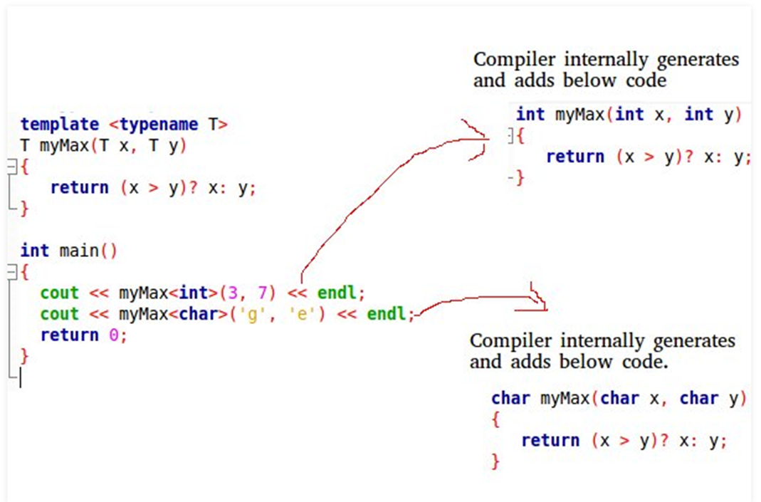

Slide 6
template<classX> //can replace 'class" keyword by "typename" keyword
X func( Xa,Xb)
{
return a;
}
int main()
count<<func(15,8),,endl; //func(int,int);
count,,func('p','q'),,endl; //func(char,char);
count<<func(7.5,9.2),,endl; //func(double,double)
return();
}

Slide 7
Function Templates
We write a generic function that can be used for different data types.
Examples of function templates are sort(), max(), min(), printArray().
// One function works for all data types. This would work // even for user defined types if operator '>' is overloaded
template <typename T>
T myMax(T x, T y)
{
return (x > y)? x: y;
}
int main() {
cout << myMax<int>(3, 7) << endl; // Call myMax for int
cout << myMax<double>(3.0, 7.0) << endl; // call myMax for double
cout << myMax<char>('g', 'e') << endl; // call myMax for char
return 0;
}

Slide 8
template <class T>
T GetMax (T a, T b) {
T result;
result = (a>b)? a : b;
return (result);
}
int main () {
int i=5, j=6, k;
long l=10, m=5, n;
k=GetMax<int>(i,j);
n=GetMax<long>(l,m);
cout << k << endl;
cout << n << endl;
return 0;
}
As you can see, the type T is used within the GetMax() template function even to declare new objects of that type:
T result;
Therefore, result will be an object of the same type as the parameters a and b when the function template is instantiated with a specific type.
In this specific case where the generic type T is used as a parameter for GetMax the compiler can find out automatically which data type has to instantiate without having to explicitly specify it within angle brackets

Slide 9
template <class T>
T GetMax (T a, T b) {
return (a>b?a:b);
}
int main () {
int i=5, j=6, k;
long l=10, m=5, n;
k=GetMax(i,j);
n=GetMax(l,m);
cout << k << endl;
cout << n << endl;
return 0;
}
int i,j;
GetMax (i,j);
Since both i and j are of type int, and the compiler can automatically find out that the template parameter can only be int.
int i;
long l;
k = GetMax (i,l);
This would not be correct, since our GetMax function template expects two arguments of the same type, and in this call to it we use objects of two different types.

Slide 10
template <class T, class U>
T GetMin (T a, U b) {
return (a<b?a:b);
}
In this case, our function template GetMin() accepts two parameters of different types and returns an object of the same type as the first parameter (T) that is passed. For example,
int i,j;
long l;
i = GetMin<int,long> (j,l);
or simply:
i = GetMin (j,l);
even though j and l have different types, since the compiler can determine the appropriate instantiation anyway.

Slide 11
#include <iostream> using namespace std;
// A template function to implement bubble sort. // We can use this for any data type that supports
// comparison operator < and swap works for it.
template <class T>
void bubbleSort(T a[], int n) {
for (int i = 0; i < n - 1; i++)
for (int j = n - 1; i < j; j--)
if (a[j] < a[j - 1])
swap(a[j], a[j - 1]);
}
int main() { // Driver Code
int a[5] = {10, 50, 30, 40, 20};
int n = sizeof(a) / sizeof(a[0]);
bubbleSort(a, 5); // calls template function
cout << " Sorted array : ";
for (int i = 0; i < n; i++)
cout << a[i] << " ";
cout << endl;
return 0;
}
// CPP code for bubble sort // using template function

Slide 13
C++ Variadic Templates
using namespace std;
template<typename T>
T summation(T val) {
return val;
}
template<typename T, typename... Args>
T summation(T first, Args... args) {
return first + summation(args...);
}
int main()
{
long sum = summation(1, 2, 3, 8, 7);
cout<<"Sum of long numbers = "<<sum<<endl;
string s1 = "H", s2 = "e", s3 = "ll", s4 = "o";
string s_concat = summation(s1, s2, s3, s4);
cout<<"Sum of strings = "<<s_concat;
}
So far we have seen function templates that take a fixed number of arguments. There are also templates that take a variable number of arguments. These function templates are called variadic templates.

Slide 15
Class Templates
Like function templates, class templates are useful when a class defines something that is independent of the data type.
Can be useful for classes like LinkedList, BinaryTree, Stack, Queue, Array, etc.
Following is a simple example of template Array class

Slide 16
template <class T>
class className{
…..
public:
T memVar;
T memFunction(T args);
};
className<int> classObejct1;
className<float> classObject2;
className<char> classObject3;

Slide 17
The class that we have just defined serves to store two elements of any valid type.
For example, if we wanted to declare an object of this class to store two integer values of type int with the values 115 and 36 we would write:
mypair<int> myobject (115, 36);
this same class would also be used to create an object to store any other type:
mypair<double> myfloats (3.0, 2.18);
template <class T>
class mypair {
T values [2];
public:
mypair (T first, T second)
{
values[0]=first; values[1]=second;
}
};

Slide 18
template <class T>
class myclass {
T a, b;
public:
myclass (T first, T second)
{a=first; b=second;}
T getMaxval ();
};
template <class T>
T myclass<T>::getMaxval ()
{
return (a>b? a : b);
}
int main () {
myclass <int> myobject (100, 75);
cout<<"Maximum of 100 and 75 = "<<myobject.getMaxval()<<endl;
myclass<char> mychobject('A','a');
cout<<"Maximum of 'A' and 'a' = "<<mychobject.getMaxval()<<endl;
return 0;
}

Slide 20
template <class T>
class mypair {
T a, b;
public:
mypair (T first, T second)
{a=first; b=second;}
T getmax ();
};
template <class T>
T mypair<T>::getmax ()
{
T retval;
retval = a>b? a : b;
return retval;
}
int main () {
mypair <int> myobject (100, 75);
cout << myobject.getmax();
return 0;
}
The only member function in the previous class template has been defined inline within the class declaration itself. In case that we define a function member outside the declaration of the class template, we must always precede that definition with the template <...> prefix:
Notice the syntax of the definition of member function getmax:
template <class T>
T mypair<T>::getmax ()
Confused by so many T's? There are three T's in this declaration:
The first one is the template parameter.
The second T refers to the type returned by the function.
And the third T (the one between angle brackets) is also a requirement: It specifies that this function's template parameter is also the class template parameter.

Slide 21
template <typename T>
class Array {
private:
T *ptr;
int size;
public:
Array(T arr[], int s);
void print();
};
template <typename T>
Array<T>::Array(T arr[], int s) {
ptr = new T[s];
size = s;
for(int i = 0; i < size; i++)
ptr[i] = arr[i];
}
template <typename T>
void Array<T>::print() {
for (int i = 0; i < size; i++)
cout<<" "<<*(ptr + i); cout<<endl;
}
int main() {
int arr[5] = {1, 2, 3, 4, 5};
Array<int> a(arr, 5);
a.print();
return 0;
}

Slide 23
Can there be more than one arguments to templates?
Yes, like normal parameters, we can pass more than one data types as arguments to templates. The following example demonstrates the same.
#include<iostream>
using namespace std;
template<class T, class U>
class A {
T x;
U y;
public:
A() { cout<<"Constructor Called"<<endl; }
};
int main() {
A<char, char> a;
A<int, double> b;
return 0;
}

Slide 24
Can we specify default value for template arguments?
Yes, like normal parameters, we can specify default arguments to templates.
The following example demonstrates the same.
#include<iostream>
using namespace std;
template<class T, class U = char>
class A {
public:
T x;
U y;
A() { cout<<"Constructor Called"<<endl; }
};
int main() {
A<char> a; // This will call A<char, char>
return 0;
}

Slide 26
Interfaces and Abstract Classes in C++
Abstract Classes
Classes that have one or more pure virtual functions are said to be abstract.
Up to this point, all the classes that we have create or used have been concrete. The difference between concrete and abstract classes is that you may make an instance of a concrete class but you may not make an instance of an abstract class.
Although you can't have an instance of an abstract class, there are some things that an abstract class can still do. An abstract class can:
be a base (parent or super) class
have concrete features (both variables and functions) that can be inherited by derived (child or sub) classes
participate in polymorphism

Slide 27
Designing Strategy
An object-oriented system might use an abstract base class to provide a common and standardized interface appropriate for all the external applications.
Then, through inheritance from that abstract base class, derived classes are formed that operate similarly.
The capabilities (i.e., the public functions) offered by the external applications are provided as pure virtual functions in the abstract base class.
The implementations of these pure virtual functions are provided in the derived classes that correspond to the specific types of the application.
This architecture also allows new applications to be added to a system easily, even after the system has been defined.

Slide 28
Why we need a abstract class?
Let’s understand this with the help of a real life example.
Lets say we have a class Animal, animal sleeps, animal make sound, etc.
For now I am considering only these two behaviours and creating a class Animal with two functions sound() and sleeping().
Now, we know that animal sounds are different cat says “meow”, dog says “woof”.
So what implementation do I give in Animal class for the function sound(), the only and correct way of doing this would be making this function pure abstract so that I need not give implementation in Animal class but all the classes that inherits Animal class must give implementation to this function.
This way I am ensuring that all the Animals have sound but they have their unique sound.

Slide 29
#include<iostream>
using namespace std;
class Animal{
public:
virtual void sound() = 0; //Pure Virtual Function
void sleeping() {//Normal member Function
cout<<"Sleeping";
}
};
class Dog: public Animal{
public:
void sound() {
cout<<"Woof"<<endl;
}
};
int main(){
Dog obj;
obj.sound();
obj.sleeping();
return 0;
}

Slide 30
Rules of Abstract Class
1) As we have seen that any class that has a pure virtual function is an abstract class.
2) We cannot create the instance of abstract class. For example: If I have written this line Animal obj; in the above program, it would have caused compilation error.
3) We can create pointer and reference of base abstract class points to the instance of child class. For example, this is valid:
Animal *obj = new Dog();
obj->sound();
4) Abstract class can have constructors.
5) If the derived class does not implement the pure virtual function of parent class then the derived class becomes abstract.

Slide 31
#include <iostream>
using namespace std;
// Base class
class Shape {
public:
// pure virtual function providing interface framework.
virtual int getArea() = 0;
void setWidth(int w) {
width = w;
}
void setHeight(int h) {
height = h;
}
protected:
int width;
int height;
};

Slide 32

// Derived classes
class Rectangle: public Shape {
public:
int getArea() {
return (width * height);
}
};
class Triangle: public Shape {
public:
int getArea() {
return (width * height)/2;
}
};
int main(void) {
Rectangle Rect;
Triangle Tri;
Rect.setWidth(5);
Rect.setHeight(7);
// Print the area of the object.
cout << "Total Rectangle area: " << Rect.getArea() << endl;
Tri.setWidth(5);
Tri.setHeight(7);
// Print the area of the object.
cout << "Total Triangle area: " << Tri.getArea() << endl;
return 0;
}

Slide 33
class Apple{
public:
virtual void price() = 0; // Pure Virtual Function declaration
void ringtone(){ // Member functions
cout<<"The ringtone is: Reflection"<<endl;
}
};
class iPhoneX: public Apple{
public:
void price() {
cout<<"The price is: 65,500"<<endl;
}
};
int main(){
cout<<"Welcome to DataFlair tutorials"<<endl<<endl;
iPhoneX i;
i.price();
i.ringtone();
return 0;
}

Slide 34
// abstract base class
#include <iostream>
using namespace std;
class Polygon {
protected:
int width, height;
public:
void set_values (int a, int b)
{ width=a; height=b; }
virtual int area (void) =0;
};
class Rectangle: public Polygon {
public:
int area (void)
{ return (width * height); }
};
class Triangle: public Polygon {
public:
int area (void)
{ return (width * height / 2); }
};
int main () {
Rectangle rect;
Triangle trgl;
Polygon * ppoly1 = &rect;
Polygon * ppoly2 = &trgl;
ppoly1->set_values (4,5);
ppoly2->set_values (4,5);
cout << ppoly1->area() << '\n';
cout << ppoly2->area() << '\n';
return 0;
}

Slide 36
Interface
An interface has no implementation.
An interface class contains only a virtual destructor and pure virtual functions.
An interface class is a class that specifies the polymorphic interface i.e. pure virtual function declarations into a base class.
The programmer using a class hierarchy can then do so via a base class that communicates only the interface of classes in the hierarchy.
Every interface class should have a virtual destructor.
Virtual destructor makes sure that when a shape is deleted polymorphically, correct destructor of the derived class is invoked.

Slide 37
Differences
1 - interfaces can have no state or implementation
2 - a class that implements an interface must provide an implementation of all the method of that interface
3 - abstract classes may contain state (data members) and/or implementation (methods)
4 - abstract classes can be inherited without implementing the abstract methods (though such a derived class is abstract itself)
5 -interfaces may be multiple-inherited, abstract classes may not (this is probably the key concrete reason for interfaces to exist separately from abtract classes - they permit an implementation of multiple inheritance that removes many of the problems of general MI).
6- If you anticipate creating multiple versions of your component, create an abstract class. Abstract classes provide a simple and easy way to version your components. By updating the base class, all inheriting classes are automatically updated with the change.
Interfaces, on the other hand, cannot be changed once created. If a new version of an interface is required, you must create a whole new interface.
7-If the functionality you are creating will be useful across a wide range of disparate objects, use an interface. Abstract classes should be used primarily for objects that are closely related, whereas interfaces are best suited for providing common functionality to unrelated classes.

Slide 38
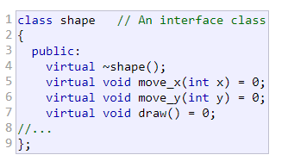

Slide 39
class shape { // An interface class
public:
virtual ~shape() {};
virtual void move_x(int x) = 0;
virtual void move_y(int y) = 0;
virtual void draw() = 0;
//...
};
class line : public shape{
public:
virtual ~line();
virtual void move_x(int x); // implements move_x
virtual void move_y(int y); // implements move_y
virtual void draw(); // implements draw
private:
point end_point_1, end_point_2;
//...
};
int main (void)
{
std::vector<shape *> shapes;
// Fill up shapes vector somehow.
for (std::vector<shape *>::iterator iter (shapes.begin());
iter != shapes.end();
++iter)
{
(*iter)->draw();
}
// Clean up shapes vector.
}
Every interface class should have a virtual destructor. Virtual destructor makes sure that when a shape is deleted polymorphically, correct destructor of the derived class is invoked. Otherwise there is a good chance of resource leak.

Slide 40
class Player {
public:
virtual void play() = 0;
virtual void stop() = 0;
virtual void pause() = 0;
virtual void reverse() = 0;
};
class Recorder: public Player {
public:
virtual void record() = 0;
};
class TapePlayer: public Recorder {
public:
void play();
void stop();
void pause();
void reverse();
void record();
};
an interface is a class

Slide 42
class Shape { // Base class
public:
virtual float area() = 0; // Pure Virtual Function
float radious(float r)
{
ar = r;
}
float SetLength(float l) {
length = l;
}
float SetBreadth(float b) {
breadth=b;
}
float SetSideSquare(float s) {
side=s;
}
protected:
float ar;
float length;
float breadth;
float side;
};

Slide 43
class Circle: public Shape{ // Derived class
public:
float area()
{
return (3.14*ar*ar);
}
};
class Rectangle: public Shape { //Derived class
public:
float area()
{
return (length*breadth);
}
};
class SideSquare: public Shape{ //Derived class
public:
float area()
{
return (side*side);
}
}
int main()
{
Circle cr;
cr.radious(3);
cout << "Area of Circle : " << cr.area() << endl;
// Print the area of circle.
Rectangle rect;
rect.SetLength(3);
rect.SetBreadth(6);
cout << "Area of Rectangle : " << rect.area() << endl;
// Print the area of rectangle.
SideSquare sq;
sq.SetSideSquare(2);
cout << "Area of Square : " << sq.area() << endl;
// Print the area of Square.
return 0;
}

Slide 45
Abstract class:
class class_Abstarct
{
public:
virtual void pure_virtual_function() = 0;
virtual void virtual_function()
{
cout << "user in virtual function" << endl;
}
};

Slide 46
Interface: Class with all pure virtual functions
class class_Interface
{
public:
virtual void pure_virtual_function_1() = 0;
virtual void pure_virtual_function_2() = 0;
};

Slide 47
class class_Interface{
public:
virtual void show_class_name() = 0;
virtual void show_developer_name(string data) =0;
};
class object_data: public class_Interface{
public:
void show_class_name() {
cout&lt;&lt;"class name : object_data"&lt;&lt;endl;
}
void show_developer_name(string data) {
cout&lt;&lt;"developer name :"&lt;&lt;data&lt;&lt;endl;
}
};
int main(){
class_Interface * data = new object_data;
data-&gt;show_class_name();
data-&gt;show_developer_name("XYZ");
return 0;
}

